Slide 1
Topics to be Covered
Basic Modular Arithmetic

Slide 2
Modular Arithmetic
Several important cryptosystems make use of modular arithmetic.
ISBN Credit Card check numbers mare determined in some way by modular arithmetic.
Modular Arithmetic is a system or arithmetic where the answer to a calculation is always in the range 0 – m where m is the modulus.
To calculate the value of n mod m, you take away (or add) as many multiples of m as possible until you are left with an answer between 0 and m.

Slide 3
Modular Arithmetic
Definition
Let a, b and n be integers and n>0.
We write a ≡ b(mod n) if and only if
n divides (a-b)
n is called the modulus
b is called the remainder
Example
29 ≡ 15 mod 7 because 7|(29-15)
12 ≡ 3 mod 9; 3 is a valid remainder since 9 divides 12-3
12 ≡ -6 mod 9; -6 is a valid remainder since 9 divides -6-3

Slide 4
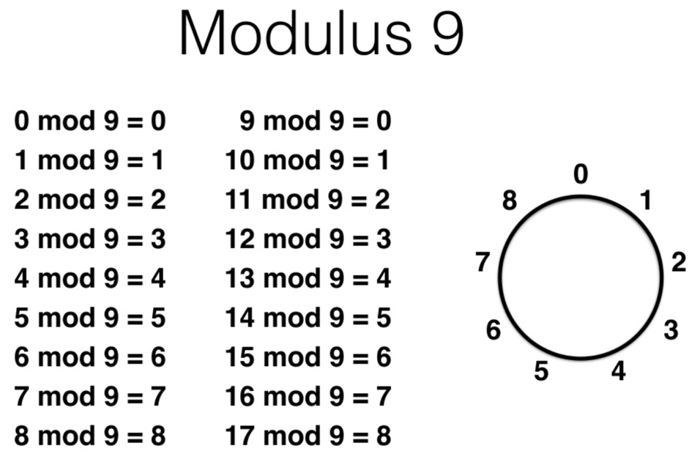
Modular Arithmetic

Slide 5
Modular Arithmetic
Two numbers a and b are said to be “congruent modulo n” if
(a mod n) = (b mod n)
written as
a ≡ b(mod n) OR
a ≡ b[mod n] OR
a ≡_{n} b
read as
a is congruent to b(mod n) OR
a and b are equivalent modulo n OR
a and b are congruent modulo n

Slide 6
Modular Arithmetic
If there is a negative number, then add as many multiples of m as necessary to get an answer in the range 0 – m-1.
Examples
17 mod 5 = 2 7 mod 11 = 7
20 mod 3 = 2 11 mod 11 = 0
-3 mod 11 = 8 -1 mod 11 = 10
25 mod 5 = 0 -11 mod 11 = 0
31 ≡ 81 [mod 2] 31 ≡₂ 81
31 ≡ 80 [mod 7] 31 ≡₇ 80

Slide 7
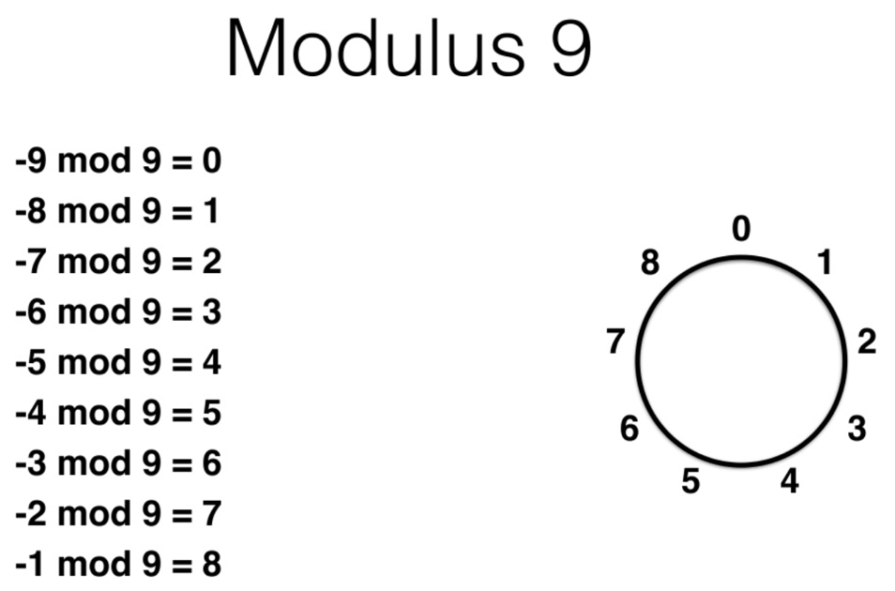
Modular Arithmetic

Slide 8
Modular Arithmetic
Given
a ≡ b(mod n)
The difference between a and b will be a multiple of n. Therefore
a - b = kn OR a = b + kn
for some value of k
E.g.1:
4 ≡ 9 ≡ 14 ≡ 19 ≡ -1 ≡ -6 mod 5
E.g.2:
73 ≡ 4(mod 23); 21 ≡ -9(mod 10)

Slide 9
Modular Arithmetic
If a ≡ 0 (mod n),
then n|a
read as
n Divides a
n Is A Factor Of a
a Is Divisible By n

Slide 10
Properties of Congruences
a ≡ b (mod n) if n|(a-b)
a ≡ b (mod n) implies b ≡ a (mod n)
a ≡ b (mod n) and b ≡ c (mod n)
implies a ≡ c (mod n)
Proof of 1.
If n|(a-b), then (a-b) = kn for some k.
Thus, we can write a = b + kn.
Therefore,
(a mod n) = (remainder when b + kn is divided by n)
= (remainder when b is divided by n)
= (b mod n).

Slide 11
Examples of a-b = kn
23 ≡ 8 (mod 5) because 23 -8 =15 = 3x5
-11 ≡ 5 (mod 8) because -11-5 =-16 = (-2)x8
81 ≡ 0 (mod 27) because 81-0=81 = 3x27

Slide 12
Properties of Modular Arithmetic
[(a mod n) + (b mod n)] mod n = (a + b) mod n
[(a mod n) - (b mod n)] mod n = (a - b) mod n
[(a mod n) x (b mod n)] mod n = (a x b) mod n
Proof of 1.
Let (a mod n) = Ra and (b mod n) = Rb. Then, we can write
a = Ra + jn for some integer j and
b = Rb + kn for some integer k.
(a + b) mod n = (Ra + jn + Rb + kn) mod n
= [Ra + Rb + (k + j) n] mod n
= (Ra + Rb) mod n
= [(a mod n) + (b mod n)] mod n

Slide 13
Examples
11 mod 8 = 3; 15 mod 8 = 7
[(11 mod 8 ) + (15 mod 8)] mod 8 = 10 mod 8 = 2
(11 + 15) mod 8 = 26 mod 8 = 2
[(11 mod 8 ) - (15 mod 8)] mod 8 = -4 mod 8 = 4
(11 - 15) mod 8 = -4 mod 8 = 4
[(11 mod 8 ) x (15 mod 8)] mod 8= 21 mod 8 = 5
(11 x 15) mod 8 = 165 mod 8 = 5

Slide 14
Properties of Modular Arithmetic
Property | Expression
Commutative Laws | (w + x) mod n = (x + w) mod n (w x x) mod n = (x x w) mod n
Associative Laws | [(w + x) + y] mod n = [w + (x + y)] mod n [(w x x) x y] mod n = [w x (x x y)] mod n
Distributive Law | [w x (x + y)] mod n = [(w x x) + (w x y)] mod n
Identities | (0 + w) mod n = w mod n (1 x w) mod n = w mod n
Additive Inverse (-w) | For each w ϵ Z_{n}, there exists a z such that w + z ≡ 0 mod n

Slide 15
Rings
A ring is a closed mathematical system with addition and multiplication operations that
Obeys certain laws (associative, distributive, etc.)
Has identities:
0 + x = x
1·x = x
The elements of a ring can be different kinds of objects:
Polynomials, sequences, numbers, etc.

Slide 16
The ring ℤ_{n}
The ring ℤ_{n} is the set {0, 1, 2, …, n-1} along with
Addition mod n
Multiplication mod n
Example: ℤ₅
+
0 1 2 3 4
x
0 1 2 3 4
01234
01234

Slide 17
Z_{n}, Residue Classes and Equivalence
Define the set Z_{n} as the set of nonnegative integers less than n:
This set is referred to as the set of residues, or residue classes (mod n). That is, each integer in Z_{n} represents a residue class.

Slide 18
Z_{n}, Residue Classes and Equivalence
We can label the residue classes (mod n) as:
[0],[1],[2],...,[n-1], where
[r] = {a: a is an integer, a ≡ r (mod n)}.
Example: n = 4
0
0
0
0
0
-9
-8
-7
-6
-5
-4
-3
-2
-1
0
1
2
3
4
5
6
7
8
9
1
1
1
1
1
-9
-8
-7
-6
-5
-4
-3
-2
-1
0
1
2
3
4
5
6
7
8
9

Slide 19
Z_{n}, Residue Classes and Equivalence
The residue classes (mod n)
[0],[1],[2],...,[n-1], where
[r] = {a: a is an integer, a ≡_{n} r}
i.e. the set of all integers that are congruent
to r modulo n.
E.g.: The residue classes (mod 4) are
[0] = {..., -16,-12,-8,-4,0,4,8,12,16, ...}
[1] = {..., -15,-11,-7,-3,1,5,9,13,17, ...}
[2] = {..., -14,-10,-6,-2,2,6,10,14,18, ...}
[3] = {..., -13,-9,-5,-1,3,7,11,15,19, ...}

Slide 20
Z_{n}, Residue Classes and Equivalence
≡_{n} induces a natural partition of the integers into n “residue” classes.
≡_{n} is an equivalence relation
Therefore
Reflexive: a ≡_{n} a
Symmetric: (a ≡_{n} b) ⇒ (b ≡_{n} a)
Transitive: (a ≡_{n} b and b ≡_{n} c) ⇒ (a ≡_{n} c)

Slide 21
Z_{n}, Residue Classes and Equivalence
The Importance of Residue Classes
When doing Addition or Multiplication mod n
Any member of a residue class may be replaced with another member (same class) and the answer will not change.
Example (Addition)
3 + 5 mod 6 = 2
(3+6) + (5+6) mod 6 = 2
9 + 11 mod 6 = 2
(9 mod 6) + (11 mod 6) mod 6 = 2

Slide 22
Z_{n}, Residue Classes and Equivalence
The Importance of Residue Classes
When doing Addition or Multiplication mod n
Any member of a residue class may be replaced with another member (same class) and the answer will not change.
Example (Multiplication)
2 * 3 mod 5 = 1
(2+5) * (3+5) mod 5 = 1
7 * 8 mod 5 = 1
(7 mod 5) * (8 mod 5) mod 5 = 1

Slide 23
Z_{n}, Residue Classes and Equivalence
The Importance of Residue Classes
…Any member of a residue class may be replaced with another member (same class)…
Example
249 * 504 mod 251
(249 mod 251) * (504 mod 251) mod 251
249 * 2 mod 251
-2 * 2 mod 251
-4 mod 251
247

Slide 24
Z_{n}, Residue Classes and Equivalence
The Importance of Residue Classes
…Any member of a residue class may be replaced with another member (same class)…
We pick one representative from the residue class and do all our calculations using these representatives. We tend to use 0, 1, 2, …, n-1.
Another Importance of Residue Classes
Computers do arithmetic modulo n, where n is 2³² or 2⁶⁴.

Slide 25
Arithmetic Computation in Z_{n}
Operations +_{n} and *_{n}:
a +_{n} b = (a + b mod n)
a *_{n} b = (a * b mod n)
Z₄ = {0, 1, 2, 3}
+ and * defined on Z₄
+ | 0 | 1 | 2 | 3
0 | 0 | 1 | 2 | 3
1 | 1 | 2 | 3 | 0
2 | 2 | 3 | 0 | 1
3 | 3 | 0 | 1 | 2
* | 0 | 1 | 2 | 3
0 | 0 | 0 | 0 | 0
1 | 0 | 1 | 2 | 3
2 | 0 | 2 | 0 | 2
3 | 0 | 3 | 2 | 1

Slide 26
Arithmetic Computation in Z_{n}
Some properties of the operation +_{n}
["Closed"]
x, y ∈ Z_{n} ⇒ x +_{n} y ∈ Z_{n}
["Associative"]
x, y, z ∈ Z_{n} ⇒ (x +_{n} y) +_{n} z = x +_{n} (y +_{n} z)
[“Commutative”]
x, y ∈ Z_{n} ⇒ x +_{n} y = y +_{n} x
Similar properties hold for *_{n}

Slide 27
Arithmetic Computation in Z_{n}
For addition tables, ALL rows and columns
are a permutation of Z_{n}
+ | 0 | 1 | 2 | 3 | 4
0 | 0 | 1 | 2 | 3 | 4
1 | 1 | 2 | 3 | 4 | 0
2 | 2 | 3 | 4 | 0 | 1
3 | 3 | 4 | 0 | 1 | 2
4 | 4 | 0 | 1 | 2 | 3
+ | 0 | 1 | 2 | 3 | 4 | 5
0 | 0 | 1 | 2 | 3 | 4 | 5
1 | 1 | 2 | 3 | 4 | 5 | 0
2 | 2 | 3 | 4 | 5 | 0 | 1
3 | 3 | 4 | 5 | 0 | 1 | 2
4 | 4 | 5 | 0 | 1 | 2 | 3
5 | 5 | 0 | 1 | 2 | 3 | 4

Slide 28
Arithmetic Computation in Z_{n}
For multiplication, SOME rows and columns
are permutation of Z_{n}, while others are not
* | 0 | 1 | 2 | 3 | 4
0 | 0 | 0 | 0 | 0 | 0
1 | 0 | 1 | 2 | 3 | 4
2 | 0 | 2 | 4 | 1 | 3
3 | 0 | 3 | 1 | 4 | 2
4 | 0 | 4 | 3 | 2 | 1
* | 0 | 1 | 2 | 3 | 4 | 5
0 | 0 | 0 | 0 | 0 | 0 | 0
1 | 0 | 1 | 2 | 3 | 4 | 5
2 | 0 | 2 | 4 | 0 | 2 | 4
3 | 0 | 3 | 0 | 3 | 0 | 3
4 | 0 | 4 | 2 | 0 | 4 | 2
5 | 0 | 5 | 4 | 3 | 2 | 1
What’s the pattern?

Slide 29
Arithmetic Computation in Z_{n}
For addition, the permutation property
means you can solve, e.g.
4 + ___ = 1 (mod 6)
4 + ___ = x (mod 6) for any x in Z₆
+ | 0 | 1 | 2 | 3 | 4 | 5
0 | 0 | 1 | 2 | 3 | 4 | 5
1 | 1 | 2 | 3 | 4 | 5 | 0
2 | 2 | 3 | 4 | 5 | 0 | 1
3 | 3 | 4 | 5 | 0 | 1 | 2
4 | 4 | 5 | 0 | 1 | 2 | 3
5 | 5 | 0 | 1 | 2 | 3 | 4
Subtraction mod n is well-defined
Each row has a 0,
hence –a is that element
such that a + (-a) = 0
⇒ a – b = a + (-b)

Slide 30
Arithmetic Computation in Z_{n}
For multiplication, if a row has a permutation, you can solve, e.g.
5 * ___ = 4 (mod 6)
or, 5 * ___ = 1 (mod 6)
* | 0 | 1 | 2 | 3 | 4 | 5
0 | 0 | 0 | 0 | 0 | 0 | 0
1 | 0 | 1 | 2 | 3 | 4 | 5
2 | 0 | 2 | 4 | 0 | 2 | 4
3 | 0 | 3 | 0 | 3 | 0 | 3
4 | 0 | 4 | 2 | 0 | 4 | 2
5 | 0 | 5 | 4 | 3 | 2 | 1

Slide 31
Arithmetic Computation in Z_{n}
But if the row does not have the permutation
property, how do you solve
no solutions!
3 * ___ = 4 (mod 6)
multiple solutions!
3 * ___ = 3 (mod 6)
* | 0 | 1 | 2 | 3 | 4 | 5
0 | 0 | 0 | 0 | 0 | 0 | 0
1 | 0 | 1 | 2 | 3 | 4 | 5
2 | 0 | 2 | 4 | 0 | 2 | 4
3 | 0 | 3 | 0 | 3 | 0 | 3
4 | 0 | 4 | 2 | 0 | 4 | 2
5 | 0 | 5 | 4 | 3 | 2 | 1

Slide 32

Exponentiation
Exponentiation is done by repeated multiplication, as in ordinary arithmetic.
$$Example$$
$Find \left(11^{7}\operatorname{mod}{1}3\right)$
We have
$11^{2}=​121≡4(\operatorname{mod}{1}3)$ $(11^{2})^{2}≡4^{2}≡3(\operatorname{mod}{1}3)$ As $11^{2}×(11^{2})^{2}×11=11^{7}$
Then
$11^{7}≡4×3×11≡132≡2(\operatorname{mod}{1}3)$

Slide 33
Simplification
With modular arithmetic, the calculated numbers are kept relatively small.
At each stage of an algorithm, the mod function is (should be) applied.
Example. To multiply 39 * 15 mod 11
We take mods to get
39 mod 11 = 6 and 15 mod 11= 4
The multiplication required is now
6*4 mod 11 = 24 mod 11 = 2

Slide 34
Euclidean Algorithm
Euclidean Algorithm
Named after Greek mathematician Euclid
Greatest Common Divisor of a and b is
- Smaller value if it evenly divides the larger value, OR
- Greatest Common Divisor of the smaller value and the remainder of the larger value divided by the smaller value

Slide 35
Euclidean Algorithm
In summary, if a is greater than b and a is not divisible by b, then
gcd(a,b) = gcd(b, b mod a)
def gcd(a, b)
if (b == 0):
return a
else:
return gcd(b, a % b)

Slide 36
Euclidean Algorithm Example
def gcd(a, b)
print (a,b)
if (b == 0):
return a
else:
return gcd(b, a % b)
>>> gcd(12,16)
12 16
16 12
12 4
4 0
4

Slide 37
Modular Arithmetic Challenge
In computing arithmetic expressions mod n, compute partial results mod n and the result is the same.
((x mod n) + (y mod n)) mod n = (x + y) mod n
((x mod n) · (y mod n)) mod n = (x · y) mod n
(158 + 219) mod 5 =
(158 · 219) mod 5 =
(34⁷⁴ + 120) mod 11
(56·72 + 62) mod 7
2¹⁰ mod 7 = (2⁵ mod 7) (2⁵ mod 7) mod 7
Any multiple of n acts like 0 mod n:
(123⁵ ·170 + 2) mod 17
(8 + 170 ·98) mod 17 =

Slide 38
Topics Covered
Basic Modular Arithmetic

